Slide 1
Module 6
70-535 Objective 2
Data Implementation
15-20% of exam
6-1
Notes:
Presentation: 75 minutes
Lab: 60 minutes
After completing this module, students will be able to:
Determine the ideal pricing option for Azure Storage based on a solution’s requirements.
Identify performance thresholds for the Azure Storage service.
Determine the type of Storage blobs to use for specific solution components.
Use the Azure Files service for SMB operations.
Identify solutions that could benefit from the use of StorSimple physical or virtual devices.
Required materials
To teach this module, you need the Microsoft PowerPoint file: 20535A_06.pptx.
Preparation tasks
To prepare for this module, you should:
Read all of this module’s materials.
Practice performing the demonstrations and labs.
Work through the Module Review and Takeaways section to determine how you will use the information to reinforce student learning and promote knowledge transfer to on-the-job performance.
As you prepare for this class, it is imperative that you complete the labs yourself. This gives you an understanding of how the labs work and the concepts that each covers, so that you can provide meaningful hints to students who might have issues. Furthermore, it will help guide your lecture to ensure that you discuss the concepts that the lab covers.
The Azure portal is continually being improved, and the user interface might have updated since this module was written. Therefore, before teaching this module, familiarize yourself with the latest version of the Azure portal.
20535A
6: Backing Azure Solutions with Azure Storage

Slide 2
Module Overview
Pricing Blob Storage Files
Notes:
20535A
6: Backing Azure Solutions with Azure Storage

Slide 3
Lesson 1: Pricing
Azure Storage Storage Account Security Storage Account Replication Storage Performance & Pricing
6-1
Notes:
20535A
6: Backing Azure Solutions with Azure Storage

Slide 4
Azure Storage
Azure provides a variety of storage features
Storage, like other services is provided in differing performance and cost levels. In addition, storage is broken down into four discrete services provided within Storage Accounts:
Blobs
Tables
Queues
Files
6-2
Notes:
Introduce storage concepts and the storage account.
Good place to discuss managed disks and mention next lesson.
20535A
6: Backing Azure Solutions with Azure Storage

Slide 5
Azure Storage Accounts
Storage accounts are further split into General Purpose and Blob Storage
Type of Account | General Purpose Standard | General Purpose Premium | Blob Storage (hot and cool access tiers)
Services Supported | Blob, File, Queue services | Blob service | Blob service
Types of Blobs supported | Block blobs, Page blobs and Append blobs | Page blobs | Block blobs and Append blobs
6-3
Notes:
Highlight the breakdown and purposes of each account type.
Talk about blobs queues tables etc.
Mention file storage and new features for hybrid scenarios life azure file sync.
Distinction between block and page blobs.
Explain blob account access tiers.
Hot – for active data.
Cool – short term backup or dr data.
Archive (blob level only) (preview).
While a blob is in archive storage, it cannot be read, copied, overwritten, or modified. No snapshots of a blob in archive storage.
Designed for long term backup.
20535A
6: Backing Azure Solutions with Azure Storage

Slide 6
Storage Account Security
Storage accounts can be secured by Azure AD or by Shared Access Signatures:
Azure AD RBAC controls management functions when applied to a Storage Account
Azure AD RBAC can be used to read data objects when applied to storage account keys
Shared Access Signatures and Stored Access Polices further secures data objects to dates times and permissions
Azure Storage can be accessed by any HTTP/HTTPS requests and has multiple storage libraries for popular languages
6-4
Notes:
Cover security aspects.
Encryption at rest and movement.
Revise sas and sap as well as rbac.
Cover storage apis and libraries.
Azure Storage resources can be accessed by any language that can make HTTP/HTTPS requests.
Additionally, Azure Storage offers programming libraries for several languages. These libraries simplify many aspects of working with Azure Storage.
Libraries are currently available for the following languages and platforms, with others in the pipeline:
Storage Services REST API https://docs.microsoft.com/rest/api/storageservices/
Storage Client Library for .NET https://docs.microsoft.com/azure/storage/blobs/storage-dotnet-how-to-use-blobs
Storage Cmdlets for PowerShell https://docs.microsoft.com/powershell/module/azure.storage/
Storage Commands for CLI 2.0 https://docs.microsoft.com/cli/azure/storage
20535A
6: Backing Azure Solutions with Azure Storage

Slide 7
Storage Account Replication
Storage account replication can be changed after creation except for Zone Redundant Storage (ZRS)
Data transfer costs my be incurred if you change from Locally redundant storage (LRS) to Geo redundant storage (GRS) - this would be a one time cost
Replication | LRS | ZRS | GRS | RA-GRS
Data stored in multiple datacenters | No | Yes | Yes | Yes
Data read from secondary & primary location | No | No | No | Yes
No of copies of data stored in separate nodes | 3 | 3 | 6 | 6
6-7
Notes:
Talk about LRS,GRS,R-GRS and ZRS.
Costs, performance.
20535A
6: Backing Azure Solutions with Azure Storage

Slide 8
Storage Performance & Pricing
Premium Storage is:
For page blobs and VM Disks
Only available as a Locally Redundant storage account
Only available for certain VM series
6-8
Notes:
Cover Premium storage creation and use.
Show which disks / vms can use premium. Do a sizing and pricing exercise to show difference.
Discuss what apps / solutions might benefit from premium disks.
SQL server, etc.
20535A
6: Backing Azure Solutions with Azure Storage

Slide 9

Discussion
When would storage performance become an issue over storage replication?
Notes:
20535A
6: Backing Azure Solutions with Azure Storage

Slide 10
Lesson 2: Blob Storage
Blob Storage Un-Managed Disks Managed Disks Deployment Considerations
6-9
Notes:
20535A
6: Backing Azure Solutions with Azure Storage

Slide 11
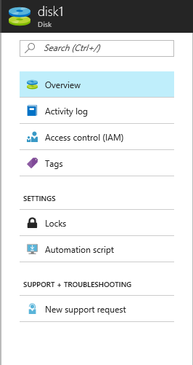
Blob Storage
All VM Disks are stored within the Azure Blob Service:
Unmanaged disks require the user to provision Storage Accounts and manage throughput
Managed disks allow Azure to handle all storage and provisioning jobs and IOPs is not a consideration
6-9
Notes:
Recap previous lesson for storage accounts containers and blob storage services.
Cover page and block blobs and the need to understand Storage account limitations.
Good chance for revision from previous topic and covering the required azure limits for storage.
There are two ways to create standard disks for Azure VMs:
Unmanaged disks:
Original method – requires storage account
Page blobs in SA can be attached to any Azure VM.
Max 256 TB per VM.
Azure Managed Disks:
Azure creates and manages storage accounts.
You choose standard or premium per disk (and can change).
Recommended option.
20535A
6: Backing Azure Solutions with Azure Storage

Slide 12
Un-Managed Disks
Require a storage account
Management overhead
Storage account IOPS limits
Choose between Standard and Premium account at creation
6-10
Notes:
Original method – requires storage account.
Page blobs in SA can be attached to any Azure VM.
Max 256 TB per VM.
20000 iops per Storage account.
Can be standard or premium disks but not in the same storage account – choose at creation for storage account performance.
20535A
6: Backing Azure Solutions with Azure Storage

Slide 13
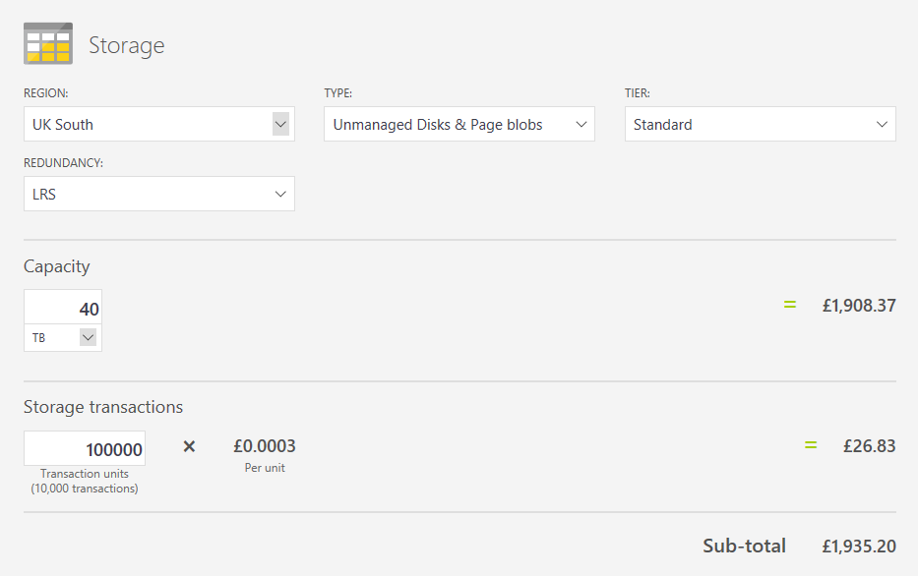
Un-Managed Disk Pricing
6-10
Notes:
20535A
6: Backing Azure Solutions with Azure Storage

Slide 14
Managed Disks
Standard and Premium disks at a disk level
Azure handles storage account and limits
Transaction billing (standard only)
Snapshots
Images
6-11
Notes:
Standard and Premium disks at a disk level – not storage account level can change at will (when unattached).
Azure handles storage account and limits – no need to spread multiple disks over a number of storage accounts for above 20000 iops performance level.
Transaction billing (standard only) – be aware for standard disks there are disk transaction costs for managed storage – see comparison slides.
Snapshots – portal based snapshot blades and management – creation of disks from snapshots.
Images – create an managed OS disk image from the portal or PowerShell or from a snapshot. (note this is also possible from a VHD in a storage account).
20535A
6: Backing Azure Solutions with Azure Storage

Slide 15
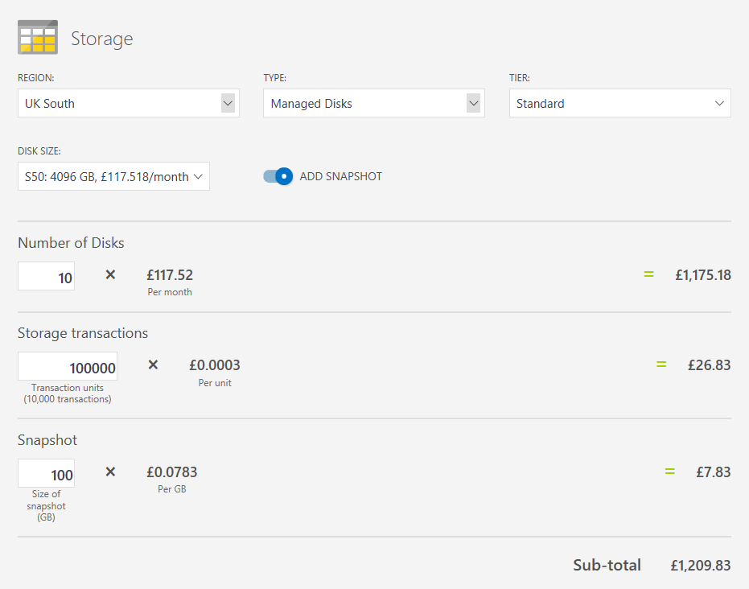
Managed Disk Pricing
6-12
Notes:
20535A
6: Backing Azure Solutions with Azure Storage

Slide 16
Deployment Considerations
Managed disks removes complexity from multiple disk VM deployments:
Can deploy with templates
Can manage with:
PowerShell
Azure CLI
Portal
Easy snapshot creation and management
Rapid performance changes
6-12
Notes:
Summary slide prior to the discussion on choices and options for deployment:
JSON template deployment so can automate full deployment.
Easy management by any method.
Snapshots and imaging from portal.
Fast and easy swap from standard to premium and back.
20535A
6: Backing Azure Solutions with Azure Storage

Slide 17
Discussion
What are the benefits and drawbacks of IaaS un-managed disk deployments?
6-12
Notes:
20535A
6: Backing Azure Solutions with Azure Storage

Slide 18
Discussion
What are the benefits and drawbacks of IaaS managed disk deployments?
6-12
Notes:
20535A
6: Backing Azure Solutions with Azure Storage

Slide 19
Lesson 3: Files
Azure Files Azure File Sync
6-14
Notes:
20535A
6: Backing Azure Solutions with Azure Storage

Slide 20
Azure Files
An SMB 3.0 file service providing reliable network file shares without infrastructure:
File Shares
File Sync
IaaS File Shares
6-14
Notes:
File Shares
File Sync
IaaS File Shares
Describe the history, needed IaaS and the drawbacks.
Describe File Share and AFS very high level.
20535A
6: Backing Azure Solutions with Azure Storage

Slide 21
Sharing Files in Cloud Infrastructure
Azure Files
Azure IaaS VM File Share
Azure File Sync for Hybrid and DR
6-14
Notes:
Detailed run through:
Azure Files
File storage offers shared storage for applications and Virtual Machines using the standard SMB 3.0 protocol.
Azure IaaS VM File Share
Standard Windows Server Files hares mounted on an IaaS VM – requires updates, maintenance and authentication of VM etc.
Azure File Sync
New preview service – allows on premises or IaaS Vms to replicate file shares using an Azure file share (cloud endpoint).
Multi server multis share with cloud tiering and dr.
20535A
6: Backing Azure Solutions with Azure Storage

Slide 22
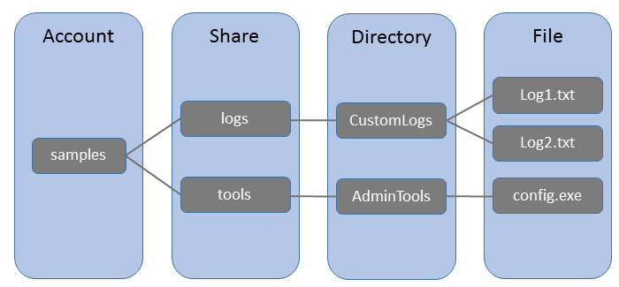
Azure File Shares
Components
URL or server / application file share access
6-15
Notes:
Azure Files:
File storage offers shared storage for applications using the standard SMB 3.0 protocol.
Storage Account: All access to Azure Storage is done through a storage account.
Share: A File storage share is an SMB 3.0 file share in Azure.
Directory: An optional hierarchy of directories.
File: A file in the share. A file may be up to 1 TB in size.
URL format: Files are addressable using the following URL format:
https://[account].file.core.windows.net/<share>/<directory/directories>/<file>
The following example URL could be used to address one of the files in the diagram above:
http://[account].file.core.windows.net/logs/CustomLogs/Log1.txt
20535A
6: Backing Azure Solutions with Azure Storage

Slide 23
Azure File Sync
File Sync Service:
NTFS volumes only
Dedupe supported (not with Cloud Tiering)
Cloud Tiering for cold files
DR feature for failed servers
6-15
Notes:
Azure File Sync terminology
Storage Sync Service – The Storage Sync Service is the top-level Azure resource for Azure File Sync.
Sync Group – A Sync Group defines the sync topology for a set of files.
Registered Server – The Registered Server object represents a trust relationship between your server (or cluster) and the Storage Sync Service.
Azure File Sync agent – The Azure File Sync agent is a download MSI that enables Windows Server to be synced with an Azure file share. Contains FileSyncSvc.exe, StorageSync.sys, PowerShell management cmdlets.
Server Endpoint – A Server Endpoint represents a specific location on a Registered Server.
Cloud Endpoint – A Cloud Endpoint is an Azure file share that is part of a Sync Group.
You can add files to servers or Azure files. Servers sync <5mins Azure files only syncs every 24 hours.
Cloud tiering – Cloud tiering is an feature of Azure File Sync in which cold files can be tiered to Azure Files. This frees space on the server. The whole namespace is still visible.
Azure File Sync compatibility 2012 R2 or 2016 with a GUI standard or datacenter.
20535A
6: Backing Azure Solutions with Azure Storage

Slide 24
Azure IaaS File Sharing
Azure AD Domain Services integrates previously created Hybrid scenarios or works as a cloud only solution. The benefits are:
Simplicity – few clicks to setup
Integrated – deep Azure AD integration
Compatible – Windows Server AD
Cost-effective – no infrastructure burden
6-15
Notes:
20535A
6: Backing Azure Solutions with Azure Storage

Slide 25
Discussion
When creating a file sharing solution, how do you decide between Azure Files, a IaaS File Server or a third-party file sharing solution?
6-15
Notes:
20535A
6: Backing Azure Solutions with Azure Storage

Slide 26
Lab: Deploying Azure Storage to Support Other Workloads in Azure
Exercise 1: Creating Required Resources for a Virtual Machine Exercise 2: Creating a VM With a Storage Account Exercise 3: Creating a VM With a Managed Disk Exercise 4: Cleanup Subscription
Logon Information
Virtual machine: 20535A-SEA-ARCH
User name: Admin
Password: Pa55w.rd
Estimated Time: 60 minutes
Notes:
This lab assumes that students have their own Azure subscriptions that do not contain any existing cloud services, storage accounts, or Azure SQL Database servers.
Azure is continually improving, so the user interface might have been updated since this lab was written. Before students start the lab, make them aware of any differences between the steps described in the lab and the current user interface.
Exercise 1: Creating Required Resources for a Virtual Machine
Exercise 2: Creating a VM With a Storage Account
Exercise 3: Creating a VM With a Managed Disk
Exercise 4: Cleanup Subscription
20535A
6: Backing Azure Solutions with Azure Storage

Slide 27
Lab Scenario
An established business has hired your company to help it transition from using Storage Accounts and blobs to managed disks in Azure.
Notes:
20535A
6: Backing Azure Solutions with Azure Storage

Slide 28
Lab Review
If you are reusing VHDs across different VMs created by various ARM templates, should you use managed or un-managed disks?
Notes:
Question
If you are reusing VHDs across different VMs created by various ARM templates, should you use managed or un-managed disks?
Answer
Answers can include:
A managed disk is a separately defined resource in an ARM template and it’s easier to author and reuse them directly in ARM templates.
Un-managed disks are not defined explicitly in ARM templates but they can be re-used if you reference the Storage account in another ARM template.
20535A
6: Backing Azure Solutions with Azure Storage

Slide 29
Module Review and Takeaways
Review Questions
Notes:
Review Questions
Question
You need to create a Storage account that supports uploading streaming data for auditing in files without overwriting already present data in those files. Which type of blobs should you use to store this data in Azure Storage?
( ) Option 1: Append blobs
( ) Option 2: Tables entities
( ) Option 3: Block blobs
( ) Option 4: File shares
( ) Option 5: Page blobs
Answer
( √) Option 1: Append blobs
( ) Option 2: Tables entities
( ) Option 3: Block blobs
( ) Option 4: File shares
( ) Option 5: Page blobs
20535A
6: Backing Azure Solutions with Azure Storage
(More notes on the next slide)

Slide 30
Notes:
Question
You have deployed an Azure VM with five attached data disks. The data disks are striped within the VM for Performance. The Azure VM uses managed disks. You need to copy the VM disks for backup and potential later reuse. What task should you perform to backup the disks?
( ) Option 1: Use Azure Backup service
( ) Option 2: Use Azure Site Recovery service
( ) Option 3: Create snapshots of individual VM disks
( ) Option 4: Detach individual VM disks and export them
( ) Option 5: Create an image of the Azure VM
Answer
( ) Option 1: Use Azure Backup service
( ) Option 2: Use Azure Site Recovery service
( ) Option 3: Create snapshots of individual VM disks
( ) Option 4: Detach individual VM disks and export them
( √) Option 5: Create an image of the Azure VM
20535A
6: Backing Azure Solutions with Azure Storage
(More notes on the next slide)

Slide 31
Notes:
Question
You need to deploy a file share to several on-premises and cloud-based IaaS Virtual Machines. Which Azure service would provide Disaster Recovery functionality for your file shares with the lowest management overhead?
( ) Option 1: Azure Site Recovery
( ) Option 2: Azure Storage File Shares
( ) Option 3: Distributed File System Replication
( ) Option 4: Azure File Sync
( ) Option 5: Azure Backup
Answer
( ) Option 1: Azure Site Recovery
( ) Option 2: Azure Storage File Shares
( ) Option 3: Distributed File System Replication
( √) Option 4: Azure File Sync
( ) Option 5: Azure Backup
20535A
6: Backing Azure Solutions with Azure Storage

Slide 32
Module Overview
Relational Databases NoSQL Services Azure Cosmos DB Data Storage & Integration Data Analysis
7-1
Notes:
20535A
7: Comparing Database Options in Azure

Slide 33
Lesson 1: Relational Databases
Azure SQL Database Third-Party Databases in Azure
7-2
Notes:
20535A
7: Comparing Database Options in Azure

Slide 34
Azure SQL Database
SQL-as-a-Service Offering:
Fully managed
Automatically replicated
Compatible with existing TDS-capable software:
Visual Studio
SQL Server Management Studio
Entity Framework
Managed using existing tools, the CLI, PowerShell or the Portal
Performance measured in a predictable manner:
Database Throughput Units (DTUs)
7-2
Notes:
DTUs are used to describe the capacity for a specific tier and performance level. DTUs are designed to be relative so that you can directly compare the tiers and performance levels. For example, the Basic tier has a single performance level (B) that is rated at 5 DTU. The S2 performance level in the Standard tier is rated at 50 DTU. This means that you can expect ten times the power for a database at the S2 performance level than a database at the B performance level in the Basic tier.
20535A
7: Comparing Database Options in Azure

Slide 35
Tiers
Tiers
Small dbs
Single active operation
Dev/Test
Small scale apps
5 DTU
Great option for cloud apps
Multiple operations
Workgroup or web apps
10 – 100 DTU
High transaction volumes
Large number of users
Multiple operations
Mission critical apps
100 – 800 DTU
BASIC
STANDARD
PREMIUM
7-3
Notes:
Migration between tiers is possible (portal, PowerShell or REST API).
20535A
7: Comparing Database Options in Azure

Slide 36
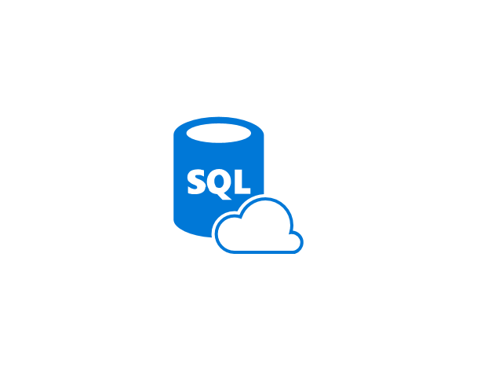

Stretch Database
Dynamically migrate transactional data from SQL Server to Azure SQL Database:
Keep cool data in lower-cost Azure storage
Keep hot data “closer” to your users in local server storage
Compatible with Always Encrypted and Row-Level Security
7-3
Notes:
20535A
7: Comparing Database Options in Azure

Slide 37
Elastic Scale
Elastic Scale simplifies the scaling out (or in) of data in Azure SQL Database
Composed of two parts:
An Elastic Scale library for client applications to configure shards and access shards
The Elastic Scale features in Azure SQL Database that implements the any changes requested by your application
7-8
Notes:
20535A
7: Comparing Database Options in Azure

Slide 38

Third-Party Databases in Azure
Azure Database for MySQL:
MySQL Community Version
phpMyAdmin Already Installed
Azure Database for PostgreSQL:
Supports PostgreSQL Extensions
7-4
Notes:
High compatibility with existing database systems.
Supports current major version and previous two major versions.
Both of the managed database services in Azure share a common set of features:
Built-in high availability with no additional cost.
Predictable performance, using inclusive pay-as-you-go pricing.
Scale on the fly within seconds.
Secured to protect sensitive data at-rest and in-motion.
Automatic backups and point-in-time-restore for up to 35 days.
Enterprise-grade security and compliance.
20535A
7: Comparing Database Options in Azure

Slide 39
Discussion
What strategy would you use to stretch your existing SQL Server data to Azure SQL Database?
7-4
Notes:
Answers will wildly vary.
Some organizations keep cool data on-premise since the existing servers are a sunk cost and keep warm data in Azure on geo-replicated instances that are closer to field offices.
Some organizations do the opposite and run Azure SQL Database at the lowest possible performance levels to save money on cool data stored in the cloud.
20535A
7: Comparing Database Options in Azure

Slide 40
Lesson 2: NoSQL Services
Azure Storage Azure Search
7-5
Notes:
20535A
7: Comparing Database Options in Azure

Slide 41
Azure Storage
Service in Azure to store various media and files
Blobs
Tables
Queues
Files
7-5
Notes:
20535A
7: Comparing Database Options in Azure

Slide 42
Storage Architecture
Import / Export
Client Libraries
(.NET, Java, C++, Android, Node.JS…)
SMB Client
REST
REST
REST
REST
SMB 2.1
Blob/Disk
Endpoint
Table
Endpoint
Queue
Endpoint
File Share
Endpoint
Front End Layer
Massive Scale Out & Auto Load Balancing Index Layer
Partition Layer
Distributed Replication Layer
Stream Layer
7-6
Notes:
Focus on how each storage service is exposed as a REST endpoint. The various clients (in RED) all can take advantage of the REST API endpoint.
20535A
7: Comparing Database Options in Azure

Slide 43
Storage Tables
NoSQL database service using the key/value (or Dictionary) design paradigm:
Can be accessed using dedicated clients or OData protocol
Built for massive scale
ODATA
devtable
caleteetstr
SAS TOKEN
TableClient
entities
table
account
7-7
Notes:
This is basically a key/value NoSQL database.
The OData protocol sits on top of the (REST API).
SAS Tokens are available to implement the Valet Key pattern.
20535A
7: Comparing Database Options in Azure

Slide 44
Migration to Cosmos DB
All existing Storage Accounts are migrating to Cosmos DB:
Existing applications can migrate to Cosmos DB with no code changes
The Cosmos DB Tables API introduced new features not found in standard Storage:
Turnkey global distribution
Dedicated throughput worldwide
Single-digit millisecond latencies at the 99th percentile
Guaranteed high availability
Automatic secondary indexing
7-7
Notes:
20535A
7: Comparing Database Options in Azure

Slide 45
Azure Search
Search-as-a-Service:
Delegates server and infrastructure management to Microsoft
Immediately ready-to-use service that you populate with search data, and then access from your application:
Accessible via REST APIs or Client SDKs
Standard search is fully scalable, with options to increase storage or service replicas for handling larger query loads
7-9
Notes:
20535A
7: Comparing Database Options in Azure

Slide 46
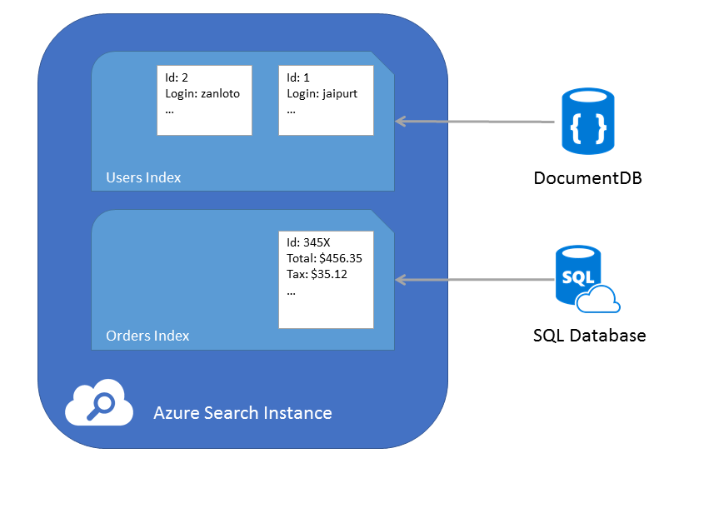
Azure Search Indexers
Search can index existing data stores including:
CosmosDB DocumentDB API
Azure SQL Database
7-9
Notes:
The indexers can add documents to individual indexes.
20535A
7: Comparing Database Options in Azure

Slide 47
Time Series Insights
Manages IoT time-series data stored in the cloud:
End-to-end service that manages:
Analytics
Storage
Visualization
Designed for terabytes of time-series data
Integrates with IoT Hubs to ingest data
7-9
Notes:
The service replaces 3-4 services that would normally perform the same functionality.
20535A
7: Comparing Database Options in Azure

Slide 48
Lesson 3: Azure Cosmos DB
Cosmos DB Consistency Levels
7-10
Notes:
20535A
7: Comparing Database Options in Azure

Slide 49





Cosmos DB
SQL
Azure Cosmos DB
Key-Value
Column-family
Documents
Graph
Global distribution
Elastic scale out
Guaranteed low latency
Five consistency models
Comprehensive SLAs
Globally distributed multi-model database engine
7-10
Notes:
A globally-distributed, multi-model database service:
First party and popular third-party OSS APIs.
Key-value, Document, Columnar, and Graph.
DocumentDB (SQL and JavaScript), MongoDB, Table, and Gremlin.
Supported across number of programming languages.
More APIs to be added.
20535A
7: Comparing Database Options in Azure

Slide 50
Global Distribution
Mission-critical applications for a global userbase need …
Global distribution
Fast, Responsive millisecond latency
Elasticity of compute and storage
Durable, Consistent and Highly available
7-10
Notes:
Worldwide presence
Automatic multi-region replication
Multi-homing APIs
Manual and automatic failovers
Latency, throughput, consistency, and availability guarantees
20535A
7: Comparing Database Options in Azure

Slide 51

APIs
Core Database
Column-family
Key-Value
Graph
Documents
SQL
7-10
Notes:
The core database “surfaces” various models and then each model can be accessed using a well-known API such as:
Cassandra
MongoDB
DocumentDB (SQL/JS)
Azure Storage Tables (Key/Value)
20535A
7: Comparing Database Options in Azure

Slide 52
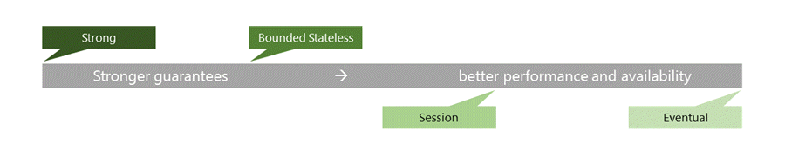
Consistency Levels
The consistency levels range from:
Strong consistency where reads are guaranteed to be visible across replicas before a write is fully committed across all replicas
Eventual consistency where writes are readable immediately and replicas are eventually consistent with the primary
7-11
Notes:
Talk about the performance differences between Strong and Eventual consistency:
Global distribution forces us to navigate the CAP theorem.
Writing correct distributed applications is hard.
Five well-defined consistency levels.
Intuitive and practical with clear PACELC tradeoffs.
Can be overridden on a per-request basis.
Refer students to their books for a full chart detailing every consistency level.
20535A
7: Comparing Database Options in Azure

Slide 53
Throughput
Each collection is assigned a performance level and that performance level dictates throughput for that collection and its corresponding documents:
If a particular collection is seeing spikes in throughput, you can manage it’s performance level in isolation by increasing or decreasing the performance level. This change to the performance level of a particular collection will not cause side effects for the other collections. This allows you to adjust to meet the performance needs of any workload in isolation.
7-11
Notes:
Pay by the hour, only what you need.
No partition management, no limits.
Change throughput at any time, effective in seconds.
Scale from 100 to 100s of millions of requests/sec across any number of regions.
Now supports requests/min to handle spikes cost-effectively.
20535A
7: Comparing Database Options in Azure

Slide 54
Discussion
What are some business scenarios where you would want to use more than one Cosmos DB API?
7-11
Notes:
20535A
7: Comparing Database Options in Azure

Slide 55
Lesson 4: Data Storage & Integration
Data Storage & Integration Options Data Integration
7-12
Notes:
20535A
7: Comparing Database Options in Azure

Slide 56
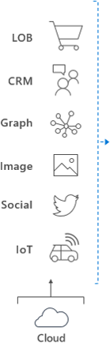

Data Storage & Integration Options
Ingest
Store
Prep & Train
Model & Serve
Data orchestration and monitoring
Big data store
Hadoop/Spark and Machine Learning
Data warehouse
7-12
Notes:
We will briefly touch on some of the data services that compose an end-to-end big data solution hosted on Azure.
Remind students that data in the cloud is covered in more depth in other Azure courses.
20535A
7: Comparing Database Options in Azure

Slide 57
SQL Data Warehouse
Model data from various sources:
Data can be ingested from sources including:
IoT
Devices
CRM
Graph Database
APIs
Other Databases
7-12
Notes:
20535A
7: Comparing Database Options in Azure

Slide 58
SQL Data Warehouse
Query and serve data to your workloads and applications:
You can query data from Data Warehouse using PolyBase
PolyBase uses T-SQL language
Data stored on well-known platform:
Data is stored, partitioned and managed using compute infrastructure nodes backed by Azure Storage
7-12
Notes:
20535A
7: Comparing Database Options in Azure

Slide 59
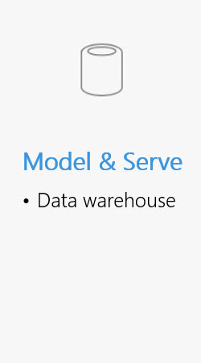
SQL Data Warehouse
Store
Query
Relational Tables Columnar Storage
PolyBase T-SQL
7-12
Notes:
Data is ingested into big-data storage from many sources including devices, IoT, social, business applications and graph databases.
SQL Data Warehouse stores data into relational tables with columnar storage.
Once we are ready for more complex analysis, we can use PolyBase in Azure SQL Data Warehouse to perform advanced queries on the data. PolyBase uses a standard T-SQL syntax.
20535A
7: Comparing Database Options in Azure

Slide 60
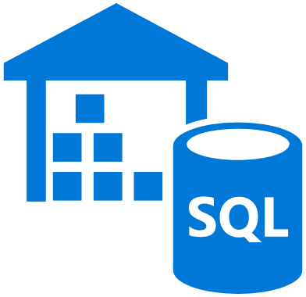


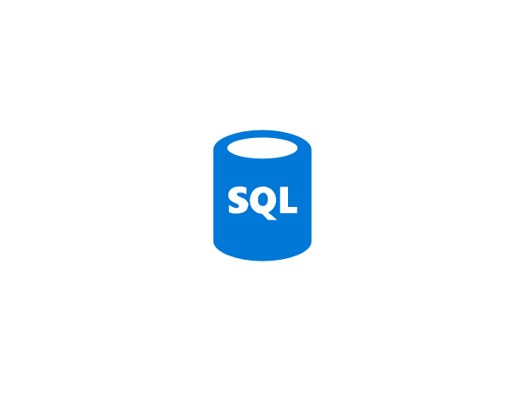

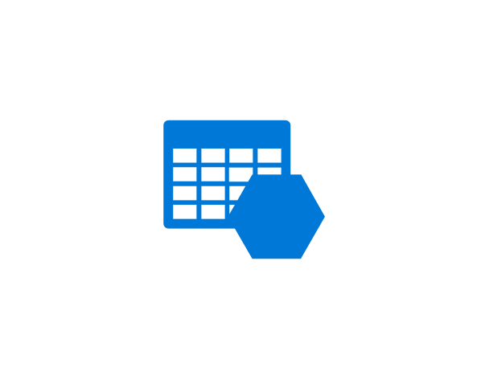

SQL Data Warehouse
Application or User
Control Node
Massively Parallel Processing (MPP) Engine
DMS
DMS
DMS
DMS
Compute Node
Compute Node
Compute Node
Compute Node
Azure Storage
7-12
Notes:
Azure SQL Data Warehouse is built on top of a “scale-out” architecture.
This enables distributed computational processing across a wide quantity of nodes.
DWU (Data Warehouse Units) or the unit of scale.
20535A
7: Comparing Database Options in Azure

Slide 61
Data Lake
Integrate a wide variety of data stores into existing workloads and applications:
Ideal for large volume scenarios that require high speed analysis and access
Store various business data stores in a centralized location:
Search and analyze the data using a single platform a U-SQL
7-13
Notes:
20535A
7: Comparing Database Options in Azure

Slide 62



Data Lake
Azure Data Lake
Analytics
U-SQL
YARN
Storage
WebHDFS
Unstructured
Semi-Structured
Structured
7-13
Notes:
Azure Data Lake is composed of two primary components: Analysis and Storage:
Analysis: Azure Data Lake uses well-known standards (like Apache Storm, Spark and Hadoop) for Analytic workloads. There is also a new data language (U-SQL) specifically designed for Azure Data Lake.
Storage: Azure Data Lake has a custom storage tier that supports a mixture of both structured and unstructured data.
The two tiers communicate using the Web HDFS (Java API) standard. YARN (Hadoop job manager) manages the running jobs for any analytic workloads.
20535A
7: Comparing Database Options in Azure

Slide 63
Data Lake
New language designed specifically for Azure Data Lake:
Combines best parts of SQL and C#
Can process any data type even without schemas
Can be used to write expressive custom code using C# syntax
U-SQL
C#
SQL
7-13
Notes:
20535A
7: Comparing Database Options in Azure

Slide 64
Data Integration
Azure Data Factory:
Compose data processing, storage and movement services to create & manage analytics pipelines
Originally focused on Azure & hybrid movement to/from on premises SQL Server:
Over time, expanded to more storage & processing systems throughout
End-to-end pipeline monitoring and management
7-14
Notes:
This is an alternative to traditional SSIS packages.
20535A
7: Comparing Database Options in Azure

Slide 65
Data Factory
Each Data Factory Solution is composed of four key components
Connect & Collect
Publish
Monitor
Transform & Enrich
7-14
Notes:
Azure Data Factory is a cloud-based data integration service that allows you to create data-driven workflows in the cloud for orchestrating and automating data movement and data transformation.
20535A
7: Comparing Database Options in Azure

Slide 66










Data Factory
Connect & Collect
Publish
Monitor
Transform & Enrich
Relational Data
Non-relational Data
7-14
Notes:
Collect from various data sources.
Transform using tools like: Apache Spark, Hadoop (or HDFS), databases (such as Cassandra, Cosmos or Mongo).
Publish to Applications and BI Platforms.
Monitor using SDKs or Azure Monitor.
20535A
7: Comparing Database Options in Azure

Slide 67





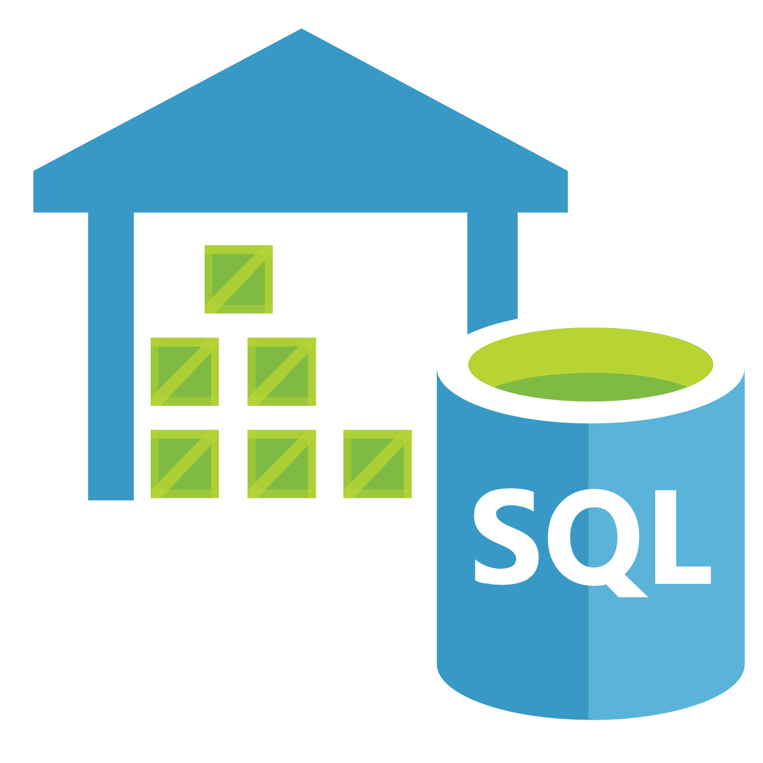



Data Factory
Azure Data Factory is an option to migrate data from Azure Data Lake to Azure SQL Data Warehouse
Azure Data Lake Analytics
Relational Database
Web Portal
Azure SQL Data Warehouse
HDFS Cluster
Interactive Analytics
Azure Data Lake Store
Power BI
Streaming Data
Azure Data Factory
7-14
Notes:
Data stored in ADL Store can be cleansed and cooked using ADL Analytics before being migrated to Azure SQL DW using Data Factory.
20535A
7: Comparing Database Options in Azure

Slide 68
Lesson 5: Data Analysis
Data Analysis Options
7-15
Notes:
20535A
7: Comparing Database Options in Azure

Slide 69
Data Analysis Options
Analysis Services:
Enterprise BI-as-a-Service
Increases efficiency of queries:
Complex raw data is optimized “behind the scenes” for search and processing
DirectQuery-caliber speeds are achievable on many data sources
Easier for users to surface data:
Data is surfaced in user-friendly business models
Users can use well-known tools, like Excel or Power BI, to query the models
7-15
Notes:
20535A
7: Comparing Database Options in Azure

Slide 70
















Analysis Services
Data Sources
Cloud
Security
Client Tools
SQL Database
In-Memory Cache
Cloud
SQL Data Warehouse
Data Modeling
Power BI
Data Lake
HDInsight/Spark
On-Premises
Other
Azure Analysis Services
Lifecycle Management
Business Logic & Metrics
Third-Party
On-Premises
Power BI Desktop
SQL Server/Oracle
Excel
Other
7-15
Notes:
Azure Analysis Services can be built “on top” of a petabyte-scale SQL Data Warehouse and Azure HDInsight Spark implementation. Tools, both cloud and on-premises, can be used to query the data using Analysis Services.
20535A
7: Comparing Database Options in Azure

Slide 71
HDInsight
Three Core Focuses:
Elastic:
Store any type of data you like (structured or unstructured)
Store when or how you like
Simple:
You should be able to create a Hadoop cluster in three minutes
Secure:
Instances are isolated by default
Built-on top of Azure Storage and Azure IaaS which both have well-known security best practices
7-15
Notes:
20535A
7: Comparing Database Options in Azure

Slide 72
HDInsight
Build your solutions on Hadoop:
Storage + proliferation of compute models for data processing at scale
Began life as an open source implementation of Google’s Map/Reduce and GFS papers
In use at many major web companies at massive scale (1000s of node, PB’s of storage)
7-15
Notes:
20535A
7: Comparing Database Options in Azure

Slide 73





HDInsight
Big data processing on top of Azure Storage
Shape
Acquire
Query
Publish
Experiment
Azure Storage
7-15
Notes:
20535A
7: Comparing Database Options in Azure

Slide 74
HDInsight
Authoring Jobs
App Integration
End User Tooling (IDE’s, Analyst tools, Command lines)
Extend breadth & depth
Enable new scenarios
Integrate with current tool chains
Lightweight
Low cost to extend
Scenario oriented
Breadth of Clients (Java, JS, .NET, etc.)
Consistent REST API’s
Connectivity
Programmability
Security
Loosely coupled
Innovation flows upward
New compute models
Perf enhancements
Core Hadoop
Authoring frameworks and languages
7-15
Notes:
20535A
7: Comparing Database Options in Azure

Slide 75
HDInsight
Sentiment Analysis
Clickstream Processing
Machine/Sensor
Server Logs
Geo-Location
Finance
Telco
Retail
Manufacturing
Transportation
Web
Prevent
Securities fraud
Compliance violations
Security breaches
Network outages
---
Machine failures
Driver & fleet issues
Application failures
Operational issues
Monitor real-time data to…
Optimize
Order routing
Pricing
Bandwidth allocation
Customer service
Offers
Pricing
Routes
Pricing
Site content
Supply chain
7-15
Notes:
20535A
7: Comparing Database Options in Azure

Slide 76
HDInsight
You can use Azure Data Lake with an Azure HDInsight cluster
Map reduce
Hive query
HBase transactions
Spark queries
Any Other HDFS Application
Azure HDInsight
Hadoop WebHDFS Client
Azure Data Lake Store
WebHDFS-compatible REST API
7-15
Notes:
20535A
7: Comparing Database Options in Azure

Slide 77
Data Catalog
Surfaces enterprise data for workloads and ad-hoc queries:
Employees can find data sets that are normally difficult to find
Data Assets can be shared among enterprise applications
Control and delegate access to data assets
Integrate data assets into existing processes using REST APIs
7-16
Notes:
The term “tribal knowledge” if often used here to describe data assets that are often only known by a few employees and needed by many employees. This tool is designed to democratize data access so that any employee can ad-hoc query appropriate data sets with minimal IT involvement.
20535A
7: Comparing Database Options in Azure

Slide 78
Data Catalog
Discover
Browse
Filter
Understand
Metadata
Experts
Consume
Data Assets
Familiar Tools
Search
Context
Existing Processes
Contribute
Tag
Document
Publish
Extend
7-16
Notes:
Many existing solutions in our companies do one or more of these tasks, but they typically take a lot of effort or time. Data Catalog extends our existing data assets with these features with a reduced amount of effort.
20535A
7: Comparing Database Options in Azure

Slide 79
Lab: Deploying Database Instances in Azure
Exercise 1: Deploying a CosmosDB Database Instance Exercise 2: Validating the REST API Exercise 3: Cleanup Subscription
Logon Information
Virtual machine: 20535A-SEA-ARCH
User name: Admin
Password: Pa55w.rd
Estimated Time: 90 minutes
Notes:
This lab assumes that students have their own Azure subscriptions that do not contain any existing cloud services, storage accounts, or Azure SQL Database servers.
Azure is continually improving, so the user interface might have been updated since this lab was written. Before students start the lab, make them aware of any differences between the steps described in the lab and the current user interface.
Exercise 1: Deploying a CosmosDB Database Instance
Exercise 2: Validating the REST API
Exercise 3: Cleanup Subscription
20535A
7: Comparing Database Options in Azure

Slide 80
Lab Scenario
A local app development firm has hired your company to show them how to automate the deployment of their API and databases. The team has used Cosmos DB for a few months to power their mobile application’s REST API. They have a test team, located on another continent, that will need the ability to deploy instances of their backend API application and database multiple times a month to perform integration and regressions testing.
Notes:
20535A
7: Comparing Database Options in Azure

Slide 81
Lab Review
How could you use multiple Cosmos DB APIs with the same database?
Notes:
Question
How could you use multiple Cosmos DB APIs with the same database?
Answer
Solutions could include:
Integrating MongoDB API with an existing service that expects MongoDB.
Using DocumentDB API with an applications that was already written for DocumentDB:
Same for Storage Tables
Using the Graph API and DocumentDB API together to perform graph traversals and CRUD on the same data set.
20535A
7: Comparing Database Options in Azure

Slide 82
Module Review and Takeaways
Review Question
Notes:
Review Question
Question
What are some of the advantages of using the Azure SQL Database service over SQL Server in a Windows or Linux VM?
Answer
Answers could include:
Automatic geo-replication without the need to setup SQL Server AlwaysOn
Elastic database support
20535A
7: Comparing Database Options in Azure

